Slide 1

DECISION MAKING ON RESTAURANT OPENING
SHOULD?
SHOULDN’T ?

Slide 2

OBJECTIVE
1-To perform a survey on Local People and understand their preferences.
2-Collecting the Data .
3-Keeping in mind the choices of the people , prepare a Dashboard to help in Deciding Whether to Open a Restaurant or Not.

Slide 3



Workflow cycle
Data collection
Data visualisation
Data cleaning and processing
1-Created a Google Form with Questionnaire to Collect the Data of Preferences of the People.
2-Transformed the Collected Response Data to Excel Spreadsheet.
1-Perform Analysis and Formatting of the Bad Data.
2-Applied formulas to Fix the Data Anomalies.
3-Replaced Blank Cells with Substitutions.
1-Loaded the Data into Power Bi Desktop.
2-With the Help of Different Charts prepared a Interactive Dashboard .
3-Generated Various Insights from the Data.

Slide 4
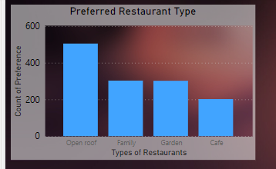
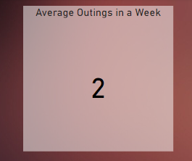
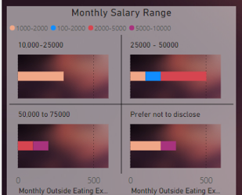
INSIGHTS FROM DATA-1
THE OPEN ROOF TYPE RESTAURANT IS MOST PREFERRED CHOICE AMONG PEOPLE.
ON AN AVERAGE PEOPLE GO TWICE ON AN OUTING IN A MONTH.
THE PEOPLE HAVING VARIED SALARY RANGES GENERALLY SPEND 1K-2K.

Slide 5
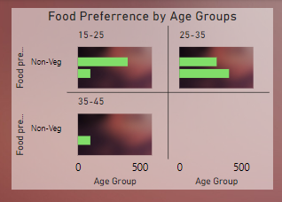
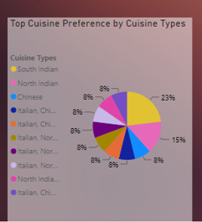
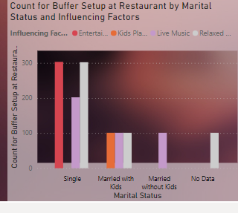
INSIGHTS FROM DATA-2
NON-VEG IS ESPECIALLY PREFERRED AMONG PEOPLE UNDER 25 YEARS AGE AND VEG IS POPULAR AMONG PEOPLE ABOVE 25 YEARS OF AGE.
SOUTH INDIAN DISH IS THE MOST PREFERRED CUSINE ALONGWITH NORTH INDIAN.
RELAXED ATMOSPHERE IS MOSTLY PREFERRED CHOICE AMONG ALL TYPE OF PEOPLE AND LIVE MUSIC IS MOST CHOOSEN FOR ENTERTAINMENT.BUFFER SETUP AT RESTAURANT IS ADVISED.

Slide 6
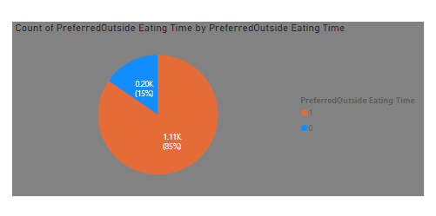
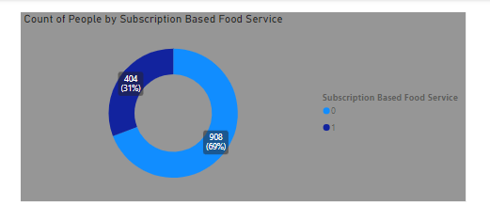
INSIGHTS FROM DATA-3
HERE 0 DENOTES ‘NO’ AND 1 DENOTES ‘YES’.PEOPLE RIGHT NOW DON’T WANT SUBSCRIPTION BASED FOOD SERVICE.
HERE ‘1’DENOTES DINNER AND ‘0’DENOTES LUNCH.DINNER IS THE RIGHT TIME FOR EATING OUTSIDE.

Slide 7

REPORT
THE CLIENT SHOULD GO WITH THE DECISION OF OPENING THE RESTAURANT.
THE RESTAURANT SHOULD BE AN OPEN ROOF TYPE.
THE CUISINES SHOULD BE SOUTH INDIAN AND NORTH INDIAN.
LIVE MUSIC AND RELAXED ATMOSPHERE IS MANDATORY.
AT PRESENT SUBSCRIPTION BASED FOOD SERVICE IS NOT REQUIRED.
NON-VEG AND VEG BOTH MENU SHOULD BE THERE.
DINNER TIME WILL HAVE MORE VISITORS SO FOCUS MORE ON THAT.

